Slide 1

The right time to buy? Interest Rates and the Housing Market Delivery 3
Dan Cimiluca
Fall 2020
Notes:
Name
Project
Attempt to understand the relationship between home prices and interest rates

Slide 2
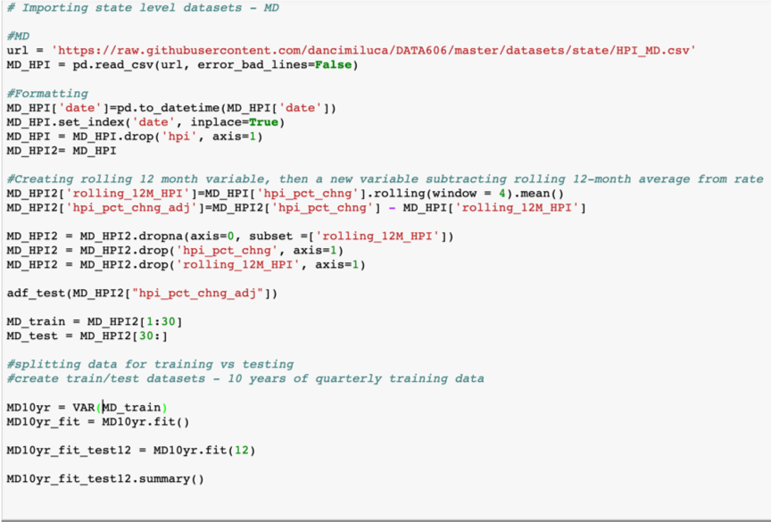
Autoregression models by state
Created models for all 50 states and Washington D.C., as well as a national level model
Quarterly data was adjusted by 4 periods to address seasonality
Notes:
autoregression models to forecast home prices

Slide 3
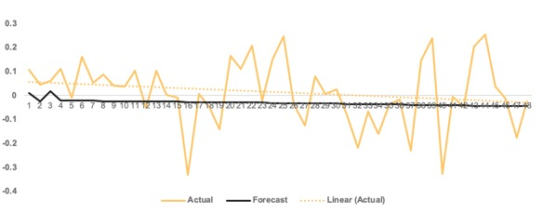
The models are not very good at predicting trends in home price change…
Autoregression – National

Slide 4

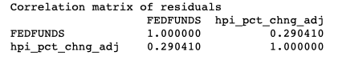
However, insight can still be gained by looking at the correlation matrix of residuals
Characterizes the joint conditional distribution of the two variables
Helps understand the relationship between the two variables over the model training period

Slide 5
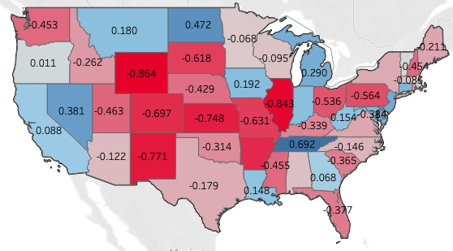
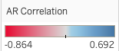
There’s a visible relationship between geographical location and how home prices and interest rates shift
5

Slide 6
Conclusions
In general, there appears to be a negative correlation between interest rates and home prices this is especially true in the Midwest, less so for costal states
This does not mean periods of rising interest rates are necessarily the right time to buy
Home prices historically increase at a fairly stable rate over time, so now could always be the best time to buy

Slide 7
Potential Next Steps
Control for compounding factors such as general economic growth or decay that impact both home prices and interest rates
Re-think modeling approach to produce more accurate models
Refresh dashboard to reflect additional metrics and keep data up to date
Develop an application that could factor expected home appreciation into determining what a borrower should be willing pay

Slide 8
Thank you for watching!
For questions or comments I can be reached at: dcimilu1@umbc.edu

